Slide 1

Lecture 6
Scanning and Mapping of Internal Network & Devices
Ethical Hacking
Diploma in CSF
Year 3 (2021/22), Semester 5

Slide 2
Learning Outcomes
At the end of this lesson, the students will be able to determine the subnets (and the associated Network ID) for a target organization. They will also be able to scan for host devices within each network found and map out the networks.

Slide 3
Learning Objectives
At the end of this workshop, students will be able to:
Explain the concept of Internal Network;
Explain the different methods to hunt down Network ID;
Make use of the tools introduced in the lecture to scan for networked devices on a targeted network; and
To map out a network infrastructure diagram of the targeted network as far as possible.

Slide 4
Contents
Recap on our Pen-Test Methodology
Concept of Internal Network
Determine Internal Networks within an Organization
Scan for Host Devices within Internal Network
Network Sweeping
Port Scanning
OS Fingerprinting
Version Scanning
Network Mapping
Other Network Scanning Tools

Slide 5

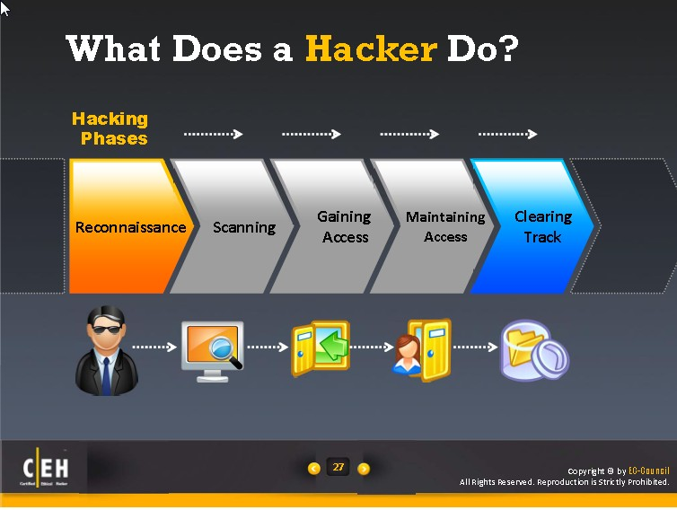
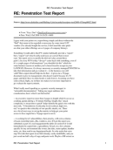
Recap: Pen-Test Process Model
Planning
Reconnaissance
Scanning
Exploit Systems
Reporting

Slide 6
Concept of Internal Network

Slide 7
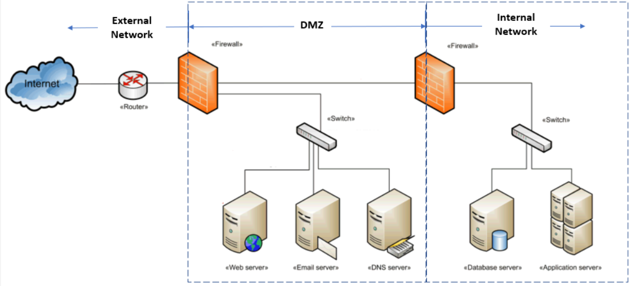
Concept of Internal Network
Below diagram depicts a typical network of an organization before the cloud era. Any devices that needs to be accessed from the Internal will be placed in the DMZ (Demilitarized zone). In this way, they can also be accessed by machines seating behind the 2nd Firewall (i.e. Internal Network).

Slide 8
The internal machines seating behind the second firewall, e.g. Database Server and Application Server use IP address of a subnet defined by the dhcp server running in the firewall.
There is also NAT (Network Translation Service) provided by the same firewall and as such machines are protected within the Internal Network as the firewall can be configured to allow certain traffics flowing in and out.

Slide 9
Determine Internal Networks within an Organization

Slide 10
Known Approaches to look for Internal Networks
This section presents the known approaches that pen-testers used to look for internal networks.
[1] Manual Method
Based on the network diagram given by the client, experienced pen-testers can easily determine the subnets that are implemented in the organization. However often and not, the network diagram is not the latest. Pen-testers need to find ways to figure out what are the new networks no on the diagram or networks already no longer exist.

Slide 11
[2] Make Formal Request
Making a formal request is permitted as long as it is NOT a Black Hat Pen-Test Project. Having a good rapport with the client and having good inter-personal skill would make this task easier. The only matter for this approach is time needed and the availability of the personnel that are able to provide you with the information that you have requested and its accuracy.
[3] Social Engineering
If permitted, this seem to be a better method to deploy to obtain information needed about the network setup. Before 9/11 event, it is easier to impersonate staff from an outsourcing company or a part-time staff to seek help from the technical personals from the target organization. If properly planned and use carefully, it should also works today for a skilled social engineer.

Slide 12
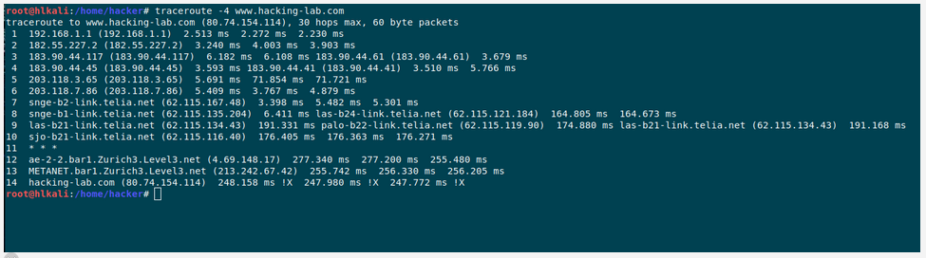
[4] Use of "tracerout" and "fping/nmap" tool in Kali Linux
This method is often not taught by others and it works thus far since the day EH was introduced. When tracerout (in Linux) or tracect (in Windows), we get a list IP addresses of the routers facing us until the destination device.

Slide 13
Each of the router's IP or destination host device IP suggest a subnet and we can use that IP and guess its network mask to deduce the network ID, e.g. 80.74.154.114, give us the network address 80.74.154.0 and 213.242.67.42 give the network ID as 213.242.67.0.
This method has a shortfall because it depends on where you execute the "traceroute“ command within the organization network and that you may missed one or more subnets.

Slide 14
Activity L6.1 – Thinking (Individual)
Think of one other method that could be used to determine the network ID of the internal network.
No submission needed.

Slide 15
Determine Host Devices within each Internal Network

Slide 16
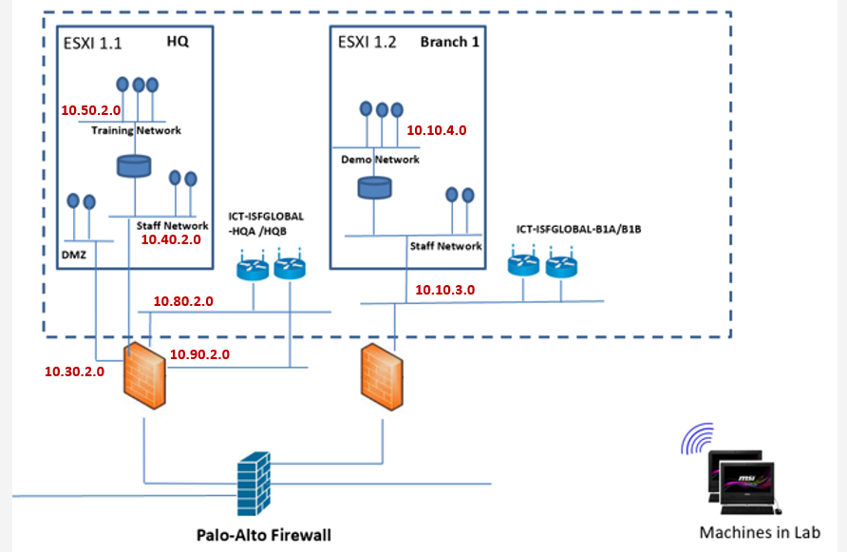
Network ID comes First
Imaging your team has been tasked to pen-test the devices housed in HQ and Branch 1 of the WoCAT System. Your team has done the basic background job and the Network ID for each of the subnets would be as follows:

Slide 17
You will find that almost all network ID information can be obtained from the scope and rules of engagement documents provided previous. This is because the documents were created by the client.
Do note that it may not be necessary in real life.

Slide 18
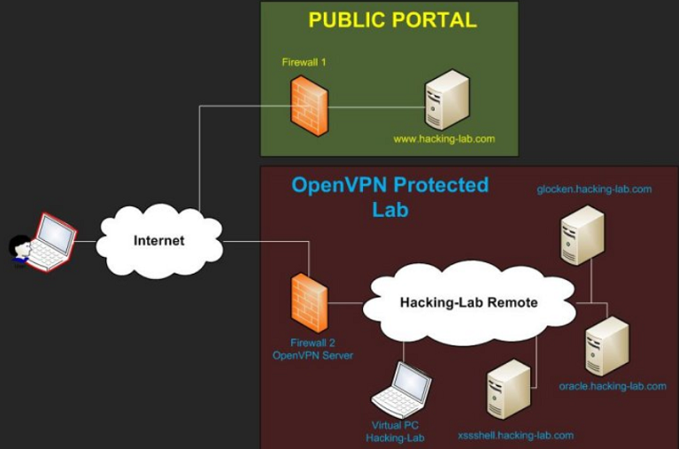
Take for example, if we want to find out what other subnets are available in the hacking-lab, you would attempt to sniff the traffics in and out of the VPN server.

Slide 19
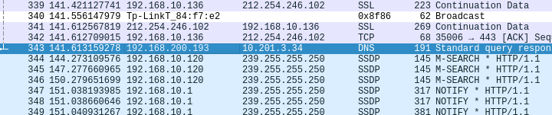
Use of Wireshark to sniff traffic in and out at the Firewall, hoping that we can find a host in the internal network talking to the device on the Internal..

Slide 20
Network Sweeping
A technique to quickly screen across a network to look for “live” devices.
Commonly used utilities - arp-scan, fping, nmap
arp-scan | fping | nmap
Use on same sub-net and returned with live host and machine’s physical or MAC address | fping is a program to send ICMP echo probes to any network hosts, similar to ping, but much better performing when pinging multiple hosts | nmap is a powerful network scanner designed to find devices and vulnerabilities within a network.
To discover all hosts on local network with the following options: arp-scan --interface=eth0 –localnet arp-scan -localnet | Usage with –g option: fping –g network_id/x fping –g startingIP endingIP -g option – generate target list | Basic usage with –n and –sP option: nmap –n –sP <subnet range> -n option means do not need to resolve to domain name. -sP says to ping the hosts only
ARP protocol only works on the local Ethernet segment, and cannot be routed. So you cannot use arp-scan to discover hosts behind routers.

Slide 21
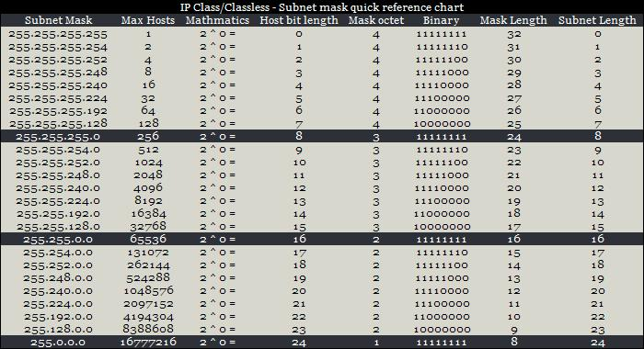
Subnet Address Table

Slide 22
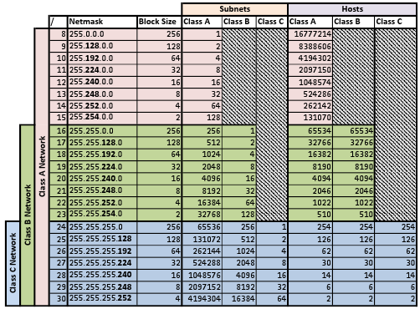

Slide 23
Sample arp-scan command
Specify a list of IP addresses as arguments | e.g. arp-scan --interface=eth0 192.168.1.1 192.168.1.2 192.168.1.3
Specify the inclusive address range in <start>-<end> format | e.g. arp-scan --interface=eth0 192.168.1.3-192.168.1.27
Specify the network in <network>/<bits> format | e.g. arp-scan --interface=eth0 192.168.1.0/24
Specify the network in <network>:<netmask> format, | e.g. arp-scan --interface=eth0 192.168.1.0:255.255.255.0
Read the list of IP addresses from a file | e.g. arp-scan --interface=eth0 --file=ip-address-list.txt
http://www.nta-monitor.com/wiki/index.php/Arp-scan_User_Guide

Slide 24
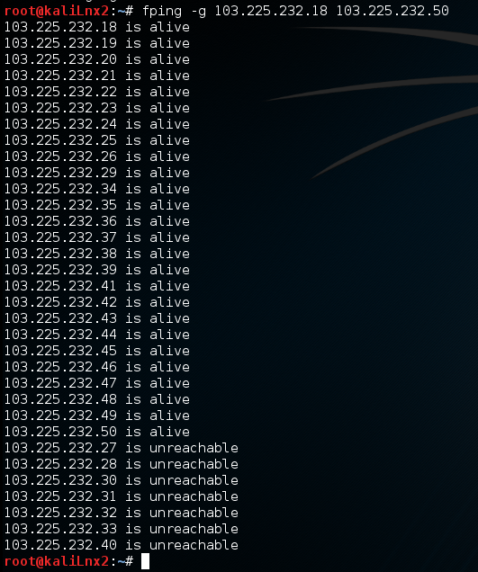
Sample fping command
Just to find out what other machines are connected to the same network…

Slide 25
How to do a blind scan using the fping options?

Slide 26
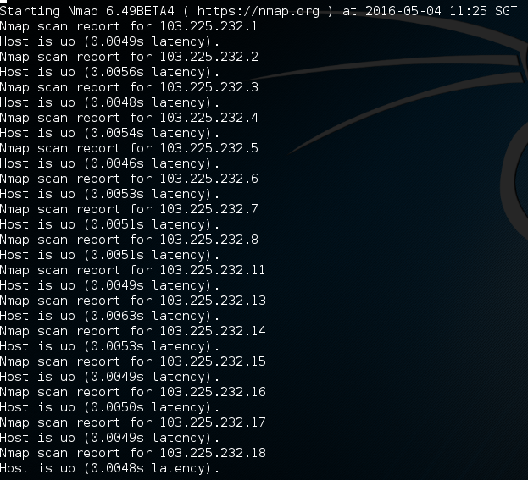
Sample nmap Command

Slide 27
Port Scanning

Slide 28
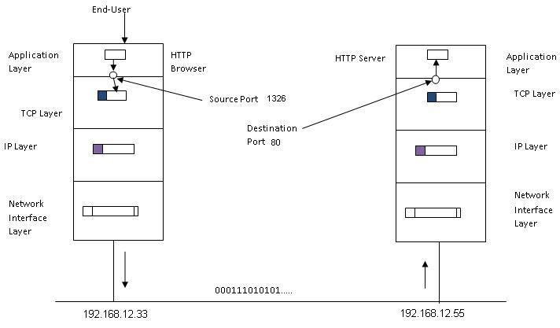
What is a port?
A port is basically a reference number that make use by the TCP Layer to identify its client (source point) and its service provider(destination port), and vice versa.

Slide 29
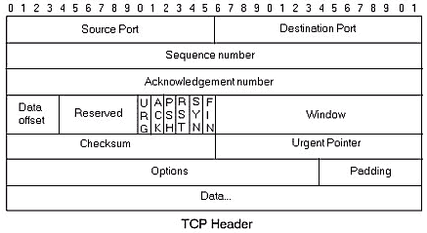
Transport Protocol Format

Slide 30
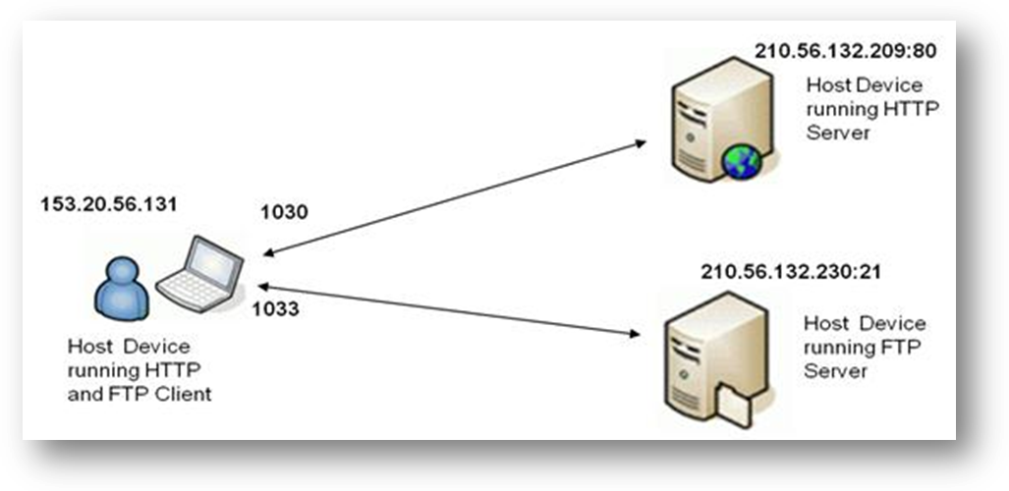
For a HTTP client to send a request to a HTTP server, it has to provide the IP address (e.g. 210.56.132.209) of the host device running the HTTP server, and the port number (e.g. 80) that the HTTP server is listening to and waiting for.
The HTTP client also needs to supply its host device IP address (e.g. 153.20.56.131) and a HTTP port number (e.g. 1030) to receive the reply from the server.

Slide 31
Port is Open?
At the server, it means the server is ready and waiting for the client’s request.
At the client, it means the client is likely waiting for reply from the server.
Port is opened would means the software layer connectivity has been established between two devices and chances that the attacker could attack the devices by making use of this port.
http://www.webopedia.com/quick_ref/portnumbers.asp

Slide 32
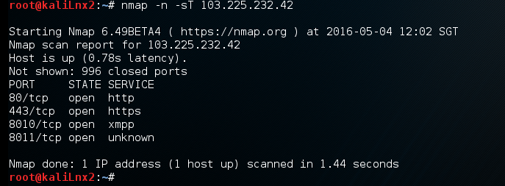
Port Scanning
An activity to look for open ports on the discovered devices.
nmap is the best tool to perform port scanning.
nmap -n –sT <target IP address>
-n option means do not need to resolve domain name
-sT option means do a full three way handshake scan, T stands for TCP

Slide 33
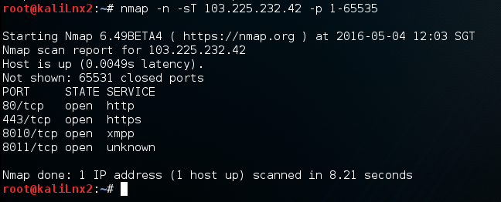
nmap –n –sT <target IP address> -p 1-65535
nmap –n –sT <target IP address> -p 21,23,25,80,135,443,6000
-p option allow user to specify the range of port or the specific ports to be scan, as to save time.

Slide 34
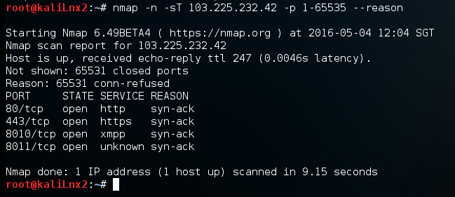
nmap –n –sT <target IP address> -p 1-65535 --reason
--reason option ask nmap to provide reasons on its decision on open or closed

Slide 35
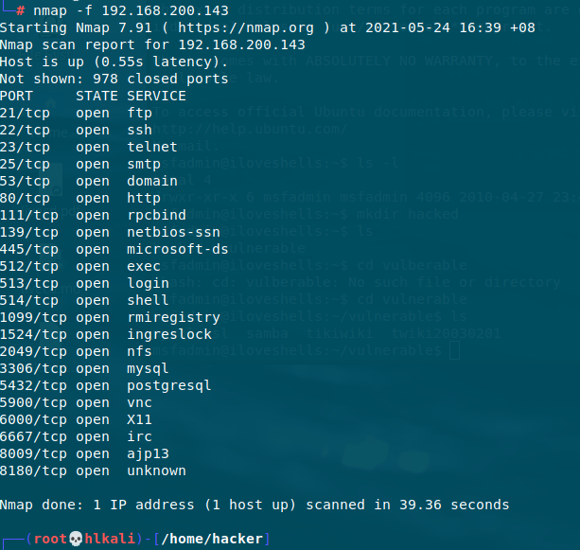

Slide 36
OS Fingerprinting

Slide 37
What is OS Fingerprinting ?
As the term suggests, finger the device so that it will reveal the type of OS it is running.
nmap -n –O –sT <target IP address>
-O option will get nmap to work on the device being scan to find out what OS it is running.
nmap -n –O –sT -p 1-1024 <target IP address>
--p option specific the port to be scanned.
nmap -n –O –sT <target IP address>/24
For all machines in the subnet
It will make the best guest….

Slide 38
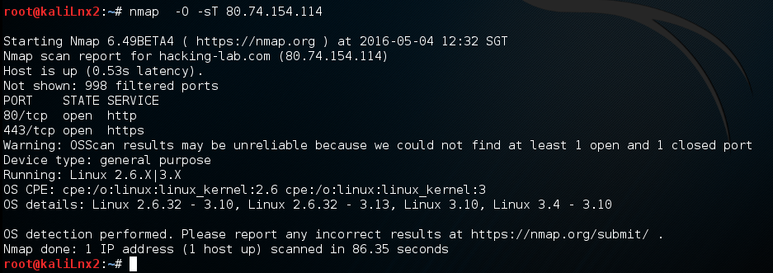
Nmap scan with OS fingerprinting command

Slide 39
Version Scanning

Slide 40
Version Scanning
This –sV option returns the version of the applications running in the device.
nmap -n –O –sT -sV <target IP address>

Slide 41
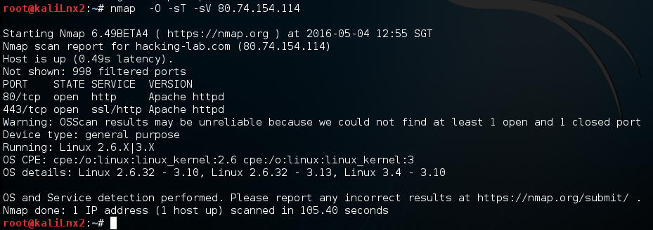
Nmap scan with version command
Returned with known version of application services.

Slide 42
Network Mapping

Slide 43
Map/Trace out the Network
This activity involves tracing out the network architecture of the target organization.
In practice and for some reasons, the client often do not have the updated network architectural diagram.
Pen-Tester needs to do whatever they can to map/trace out the network architectural diagram of the organization.
Mapping networks gives a better understanding of underlying network infrastructure of the organization.
Network mapping makes testing, evaluating security of network easy and efficient.

Slide 44
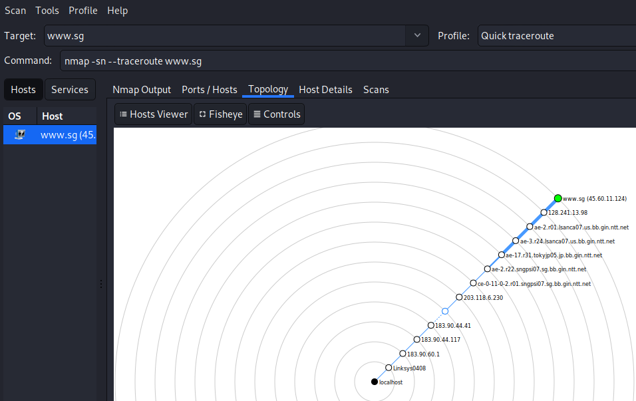
Use of Zenmap to do traceroute and map out the devices connect to the first router/gatway.
First router

Slide 45
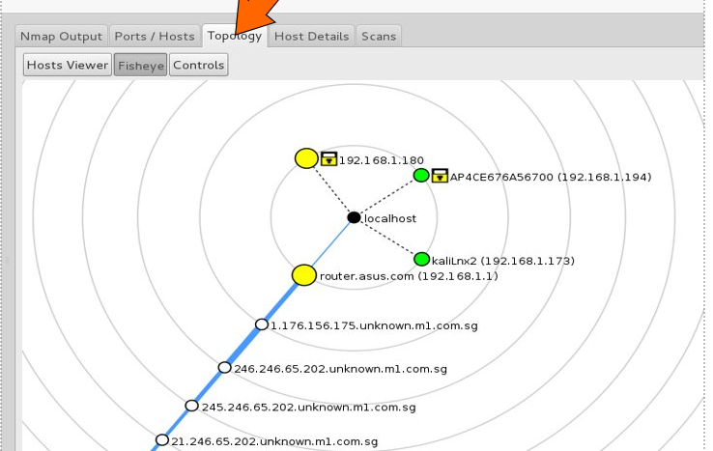
Activity L6.2 – Exploration (Individual)
Use the zenmap that you have installed in the hacking-lab CD, do not on the VPN, make sure your machine is connected to your wireless router via a RJ45 cable and the network setting of your VM is bridged.
Run the quick traceroute in zenmap to www.sg, see if you find any local machines connected to the same gateway.
No submission needed.

Slide 46
Other Scanning & Mapping Tools

Slide 47
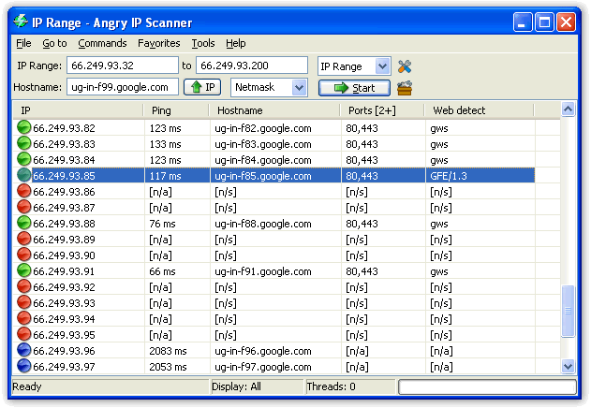
Angry IP Scanner
IP Scanner - Designed for scanning of multiple hosts
Scan an IP range and report if specific ports are open.
Pings each IP address to check if it's alive
Optionally it can resolve hostname, determines the MAC address, scans ports, etc.
The amount of gathered data about each host can be extended with plugins.

Slide 48
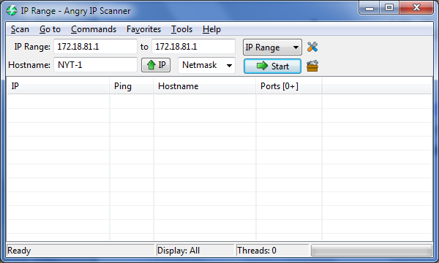
Download Angry IP Scanner from www.angryip.org/w/download
Enter the IP address of the target system in the host or IP address field or enter a range and click Start to perform a conventional scan of standard ports

Slide 49
NetCraft
Tool that fingerprint an operating system.
Used to determine the OS and web server software version numbers.
A website that periodically polls web servers to determine the operating system version and the web server software version.
Netcraft can provide useful information the hacker can use in identifying vulnerabilities in the web server software. In addition,
Netcraft has an antiphishing toolbar and web server verification tool to make sure you’re using the actual web server rather than a spoofed web server.

Slide 50
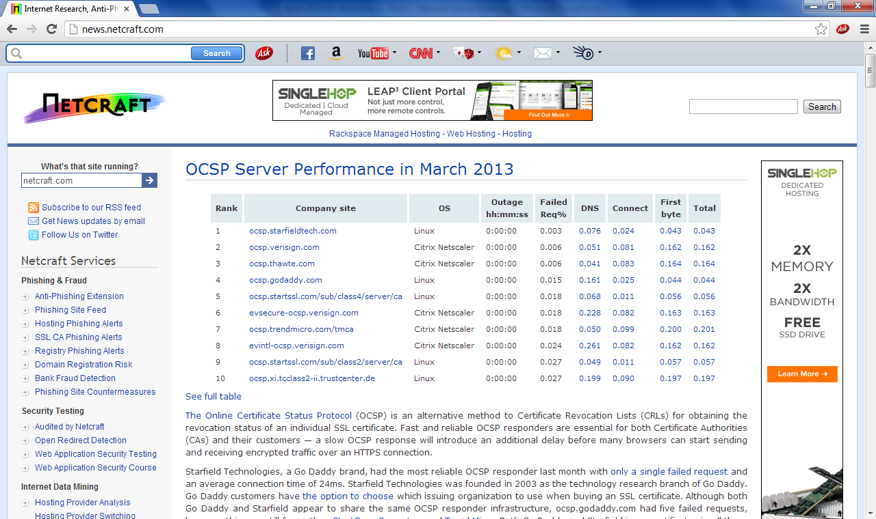
Use Netcraft to identify the OS or a web server.
Open a web browser to the Netcraft website, www.netcraft.com.
Type a website name in the What’s That Site Running? field in the upper-left corner of the screen.
Scroll down to Hosting History to see what OS and web server software are running on the server.

Slide 51
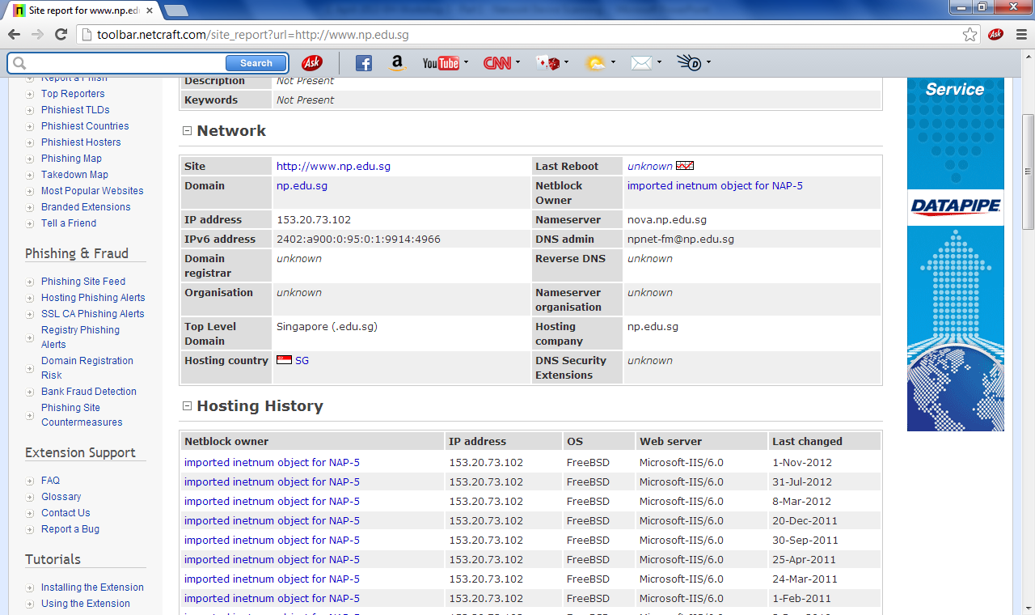

Slide 52
Summary

Slide 53
Summary
We have covered the following:
Concept of Internal Network
Determine Internal Networks within an Organization
Scan for Host Devices within Internal Network
Network Sweeping
Port Scanning
OS Fingerprinting
Version Scanning
Network Mapping
Other Network Scanning Tools

Slide 54
Q&A

